Slide 1
ENSE 470 - Milestone 4
Group Name: GLHF
Group Members:
Vincent Chan
Thiago De Melo
Shuaihao Zhao
Joe Emmanuel Samano
March 1, 2018

Slide 2
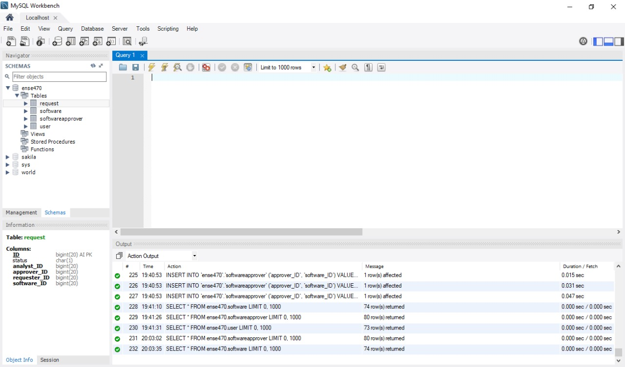
The Database
MySQL
Workbench
Hibernate
Notes:
Thiago

Slide 3
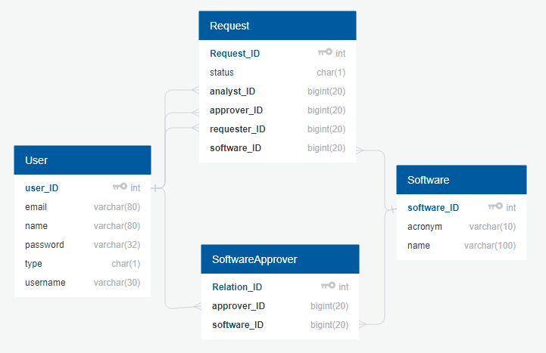
Database snapshot
Notes:
Thiago

Slide 4
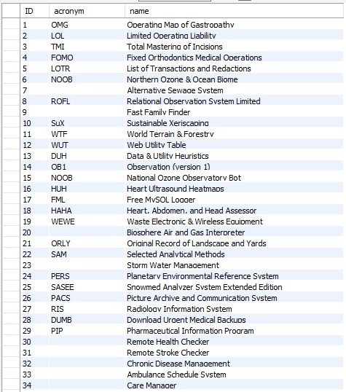
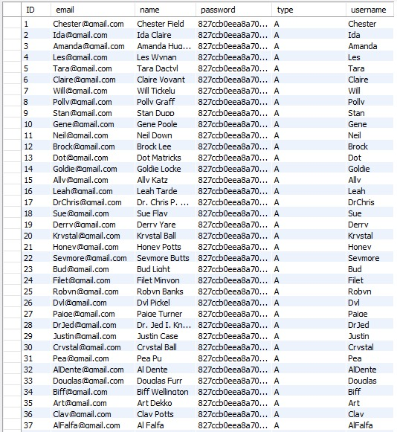
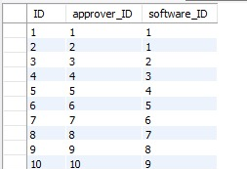
Softwares
Users
Insert tables and erd
Relation Software-Approver
Notes:
Thiago

Slide 5

Softwares
Users
Insert tables and erd
Relation Software-Approver
No requests yet
Notes:
Thiago

Slide 6
Data Cleansing
Merge
PDF file
Spreadsheet
Remove duplicated inputs
Why do not create acronym for those that do not have?

Slide 7
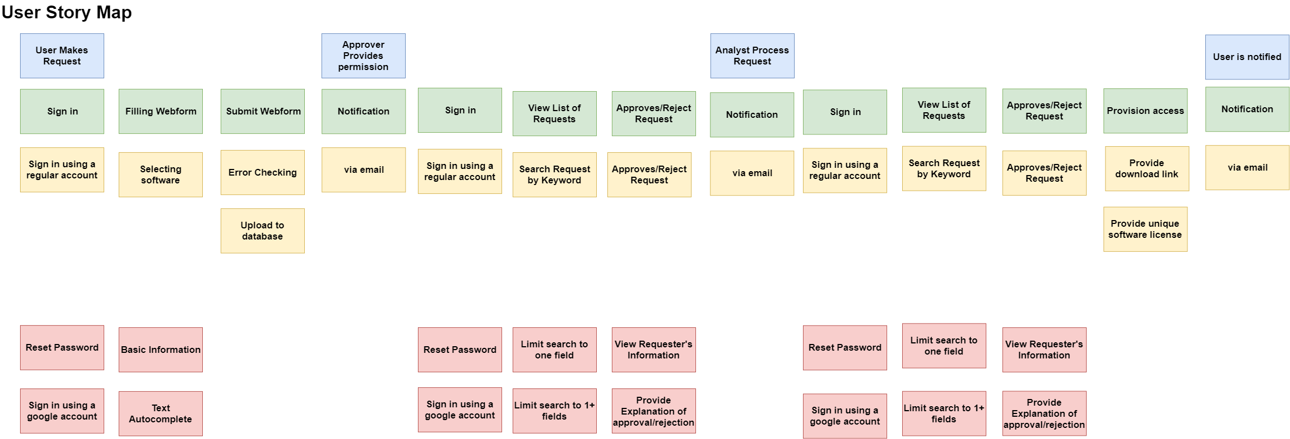
Release 1
Release 2
Notes:
Hao

Slide 8
Lo-fidelity prototype snapshots

Slide 9
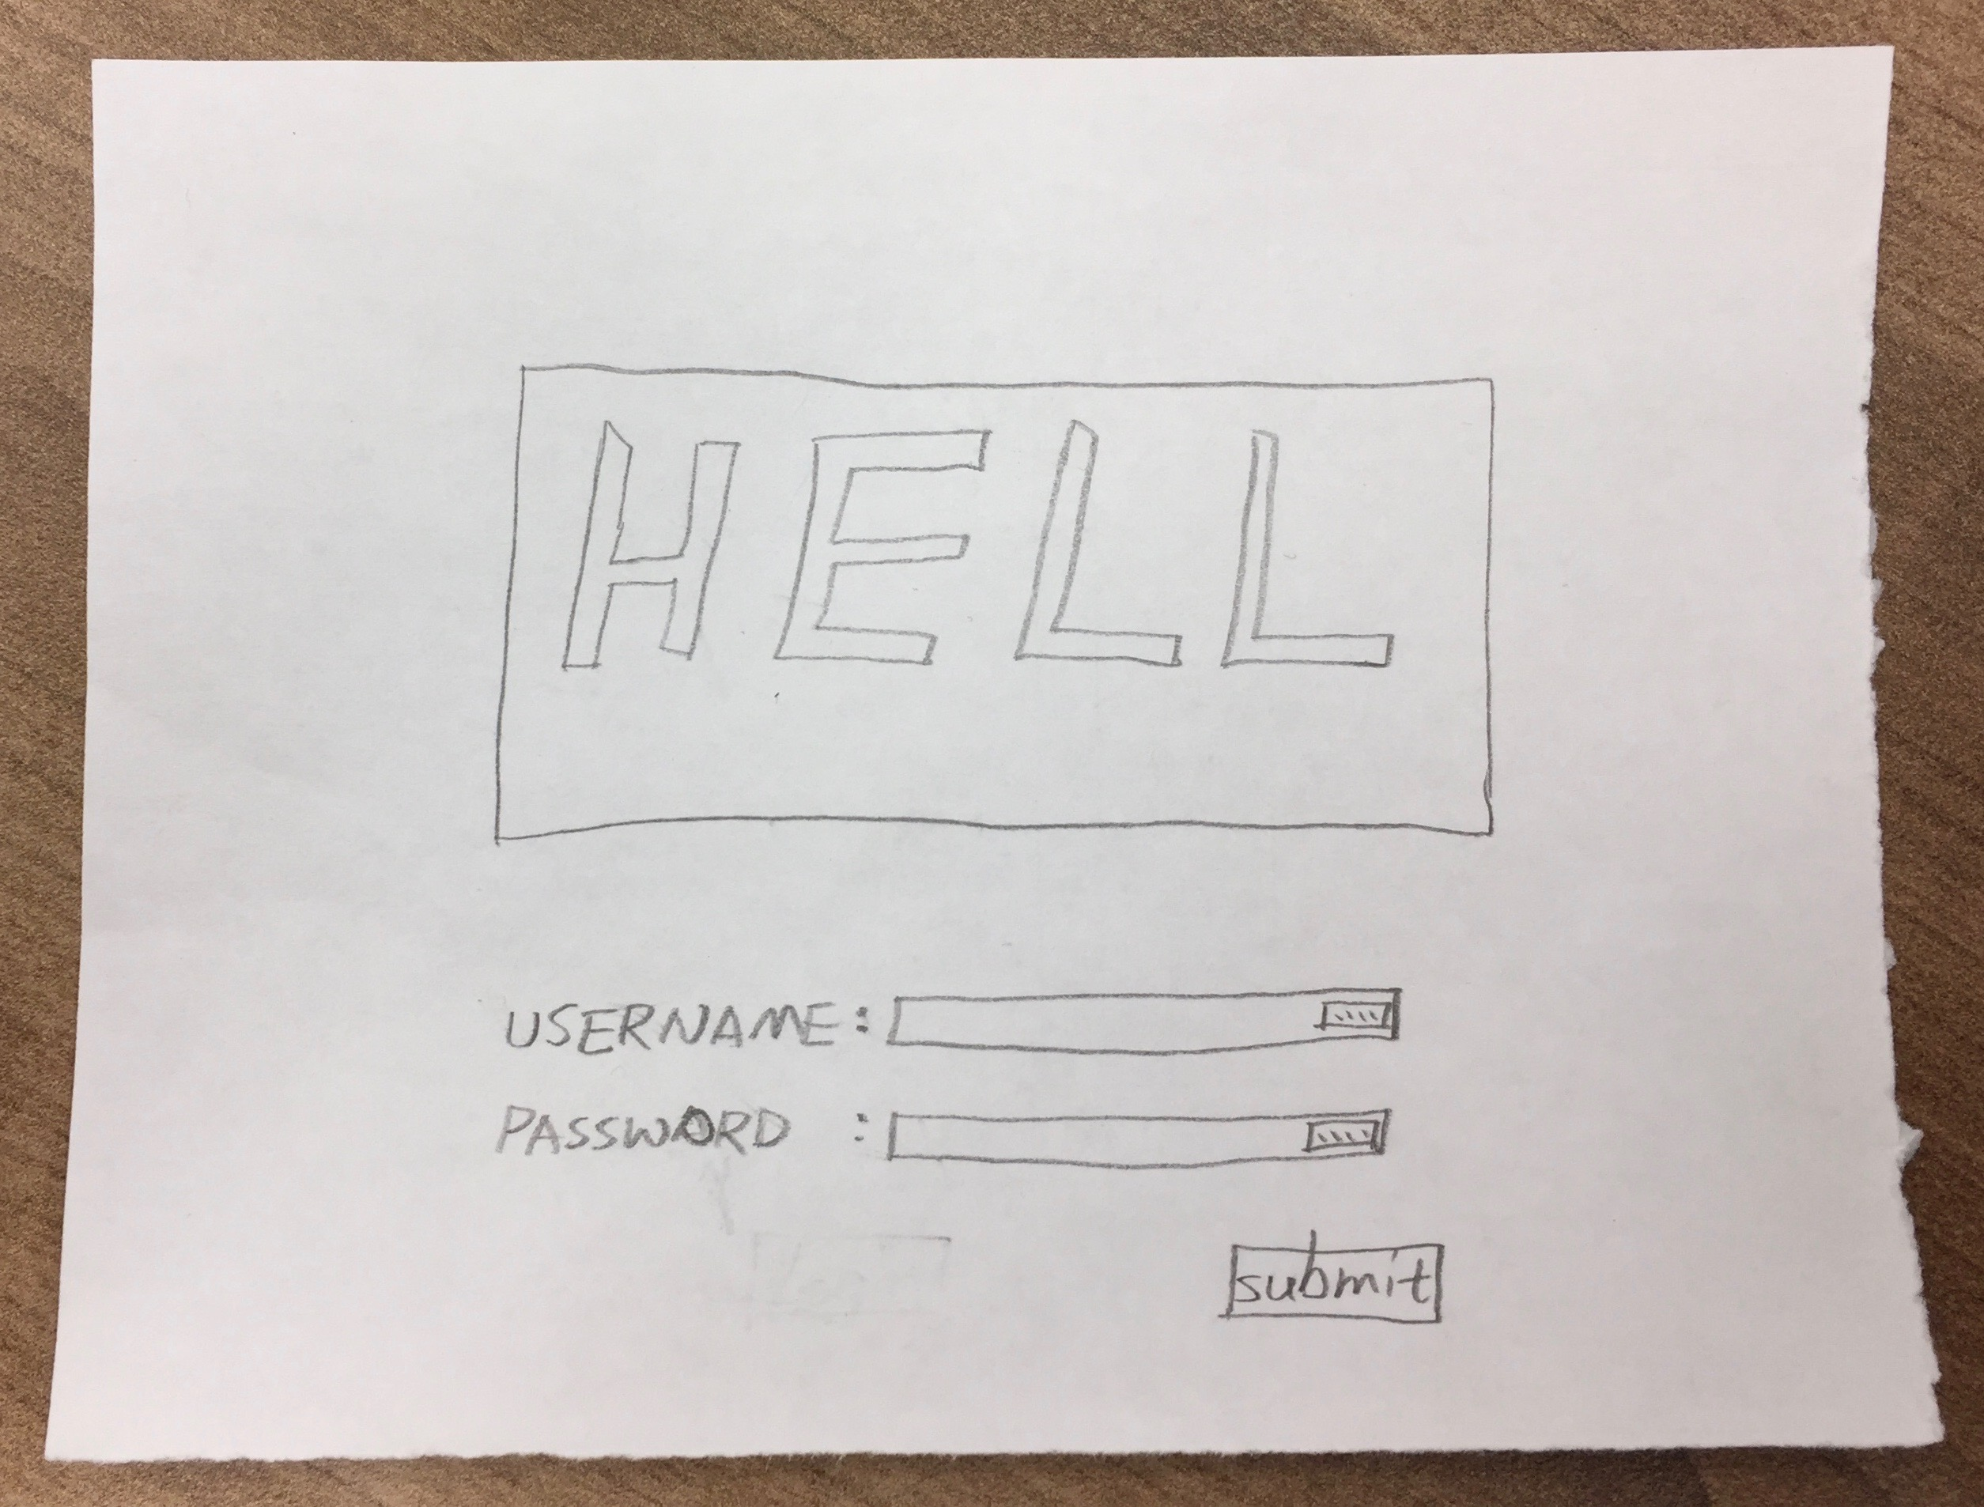
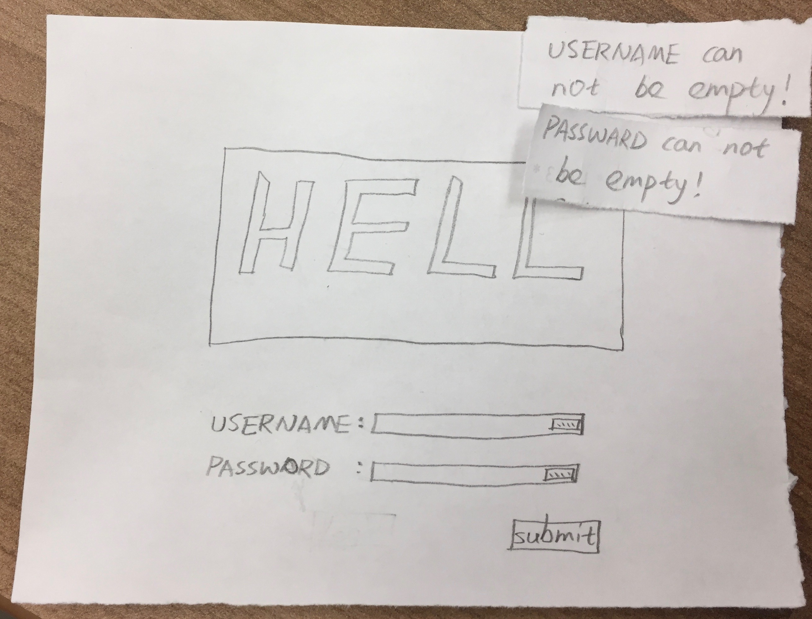
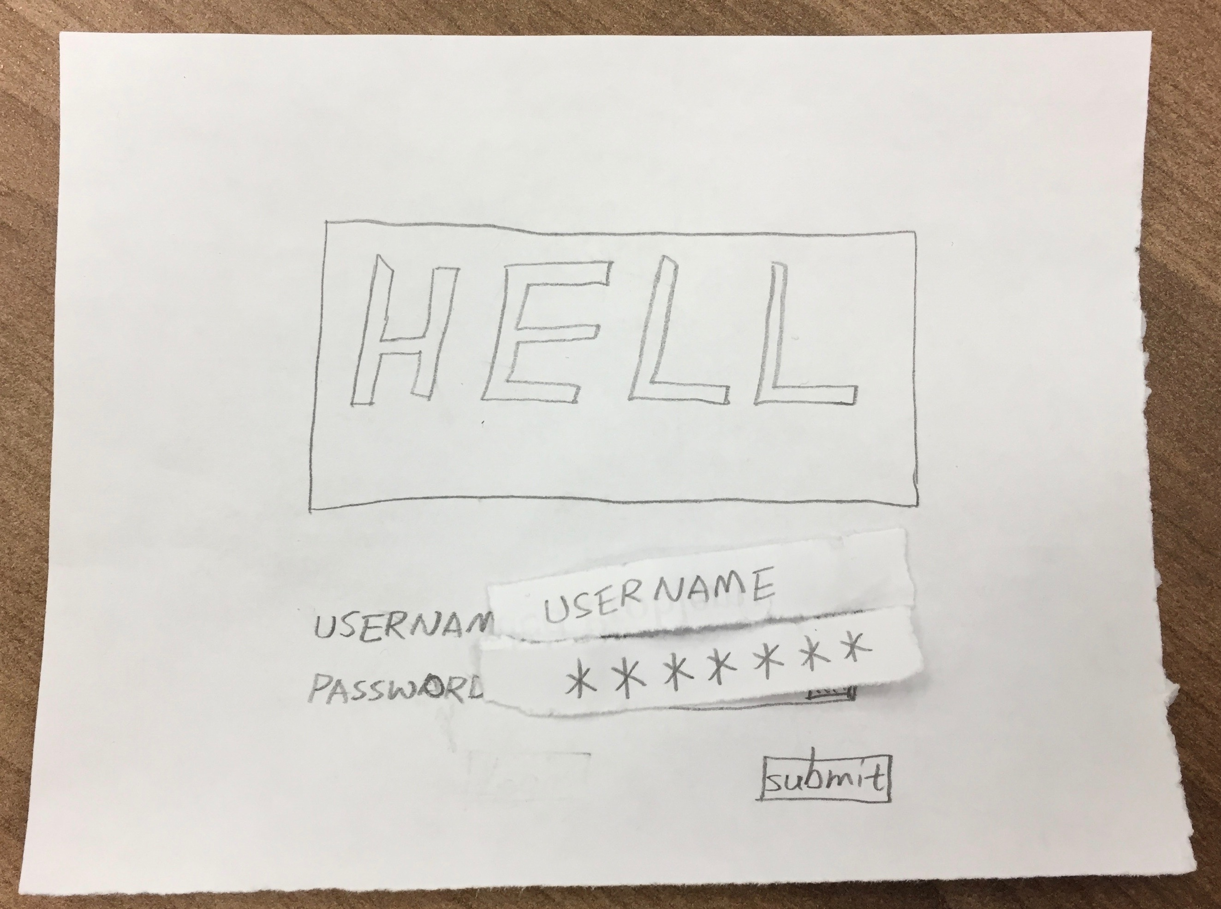
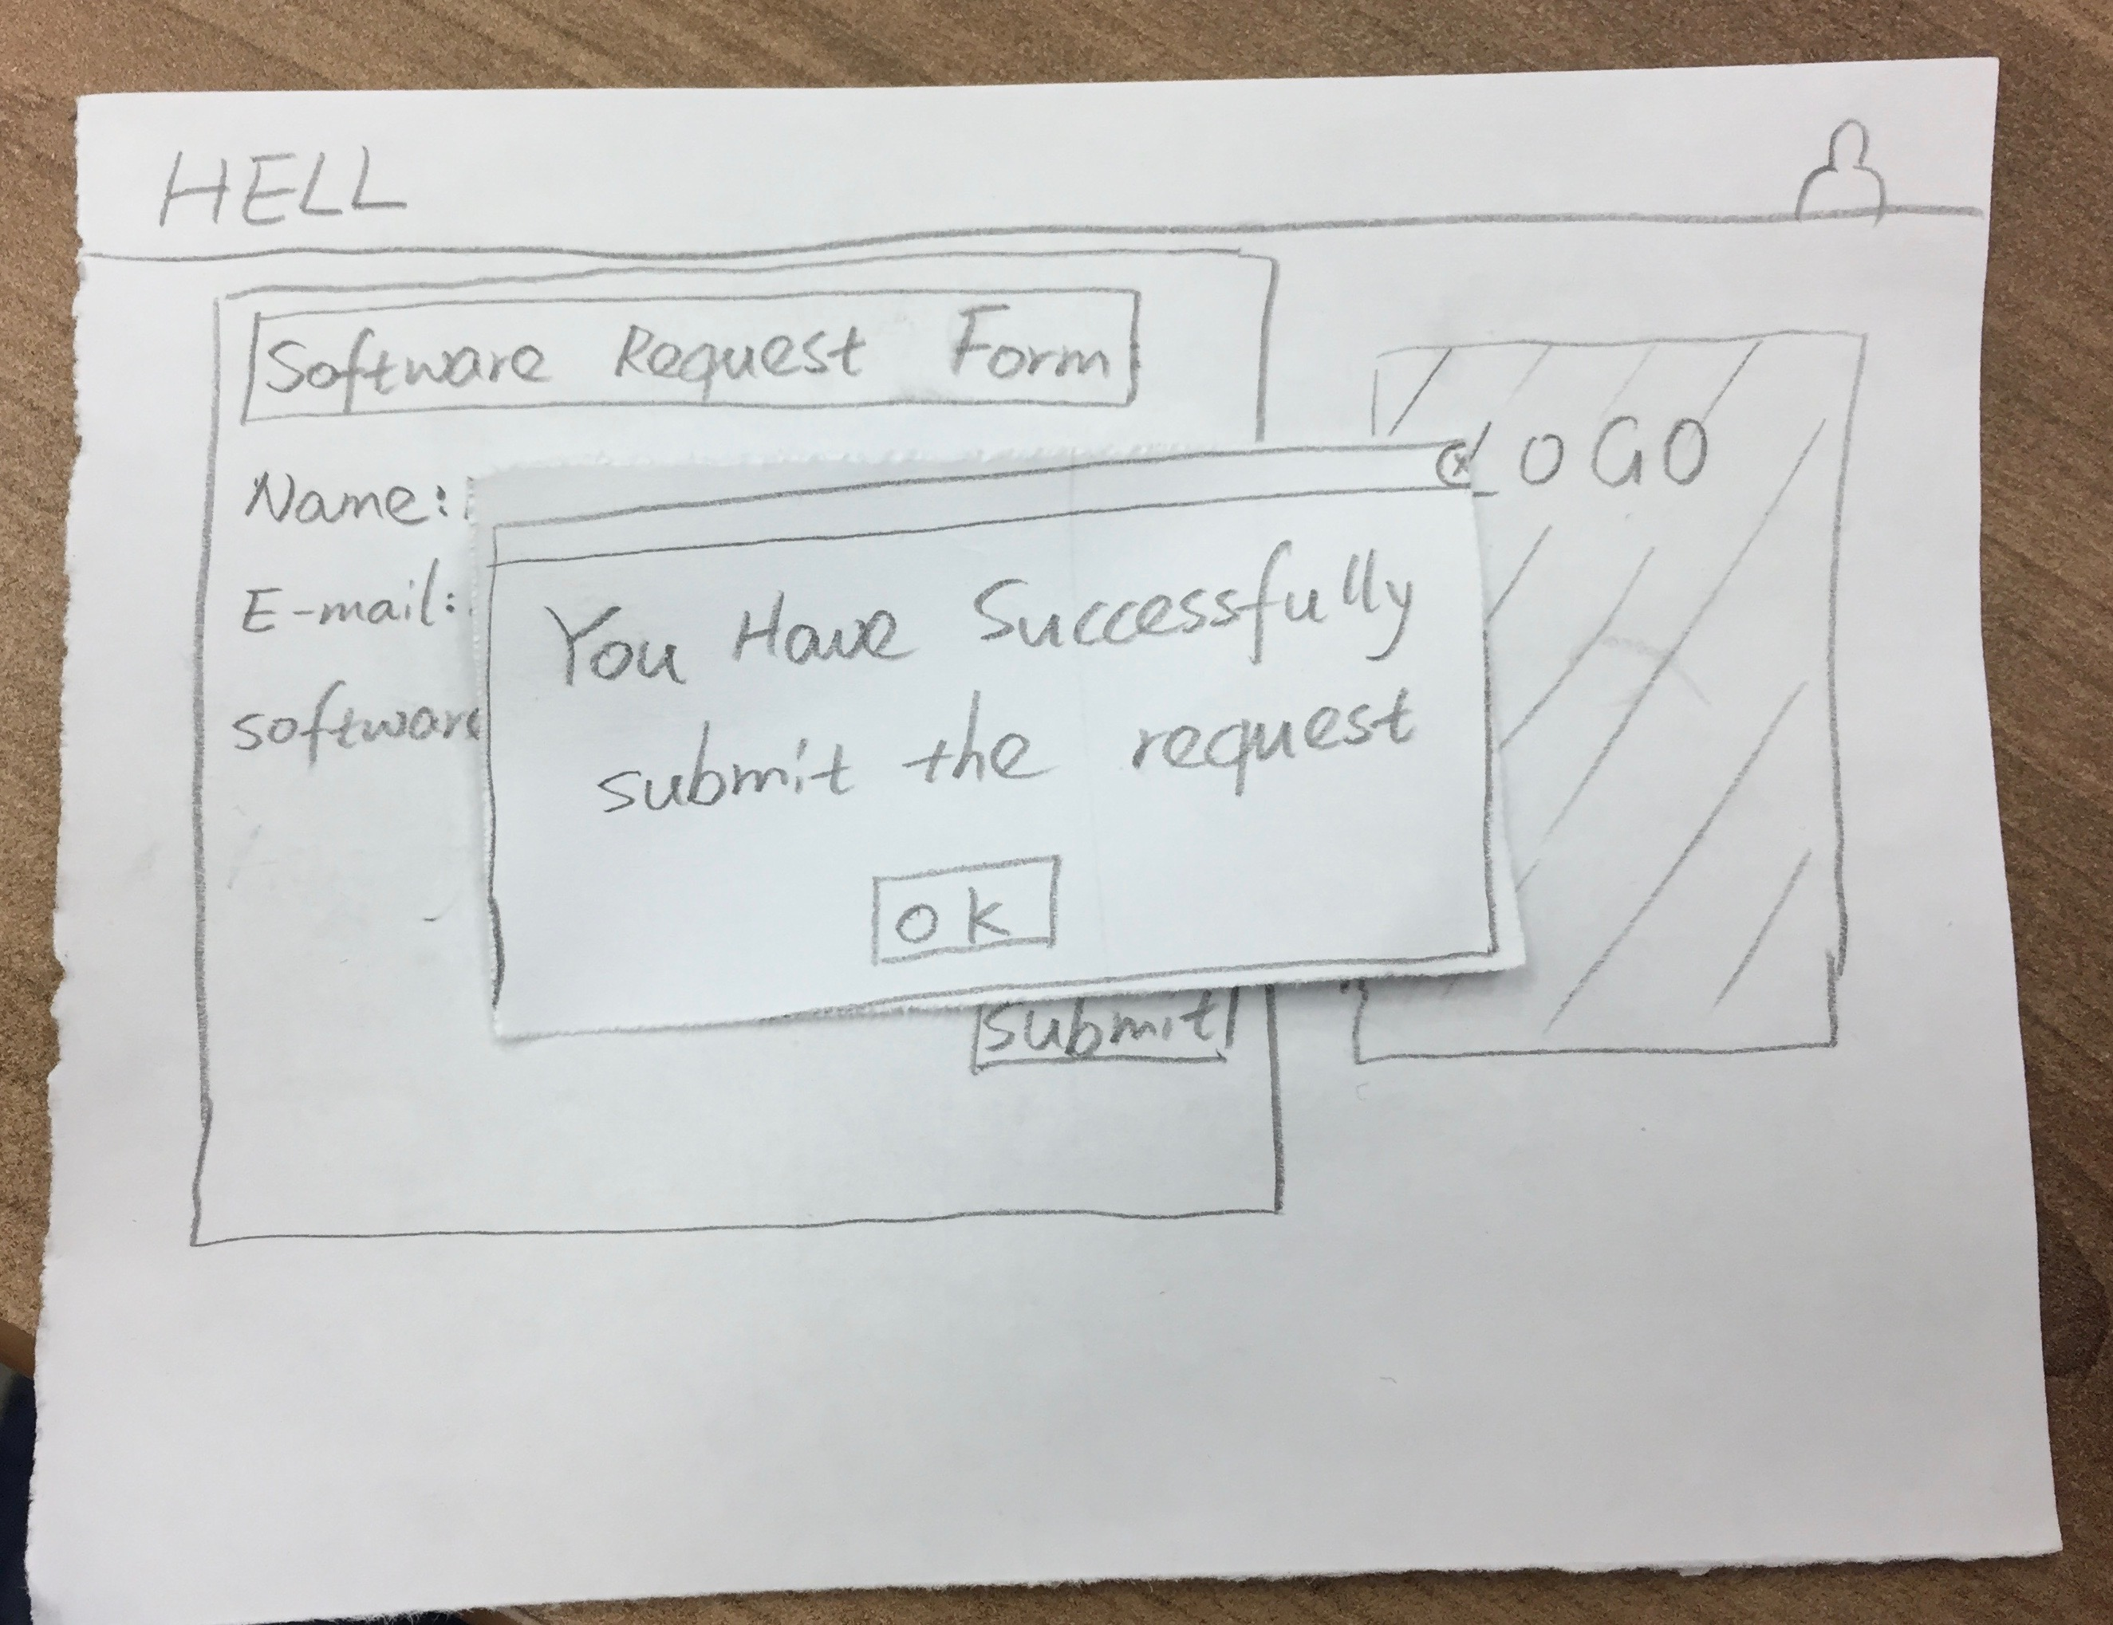
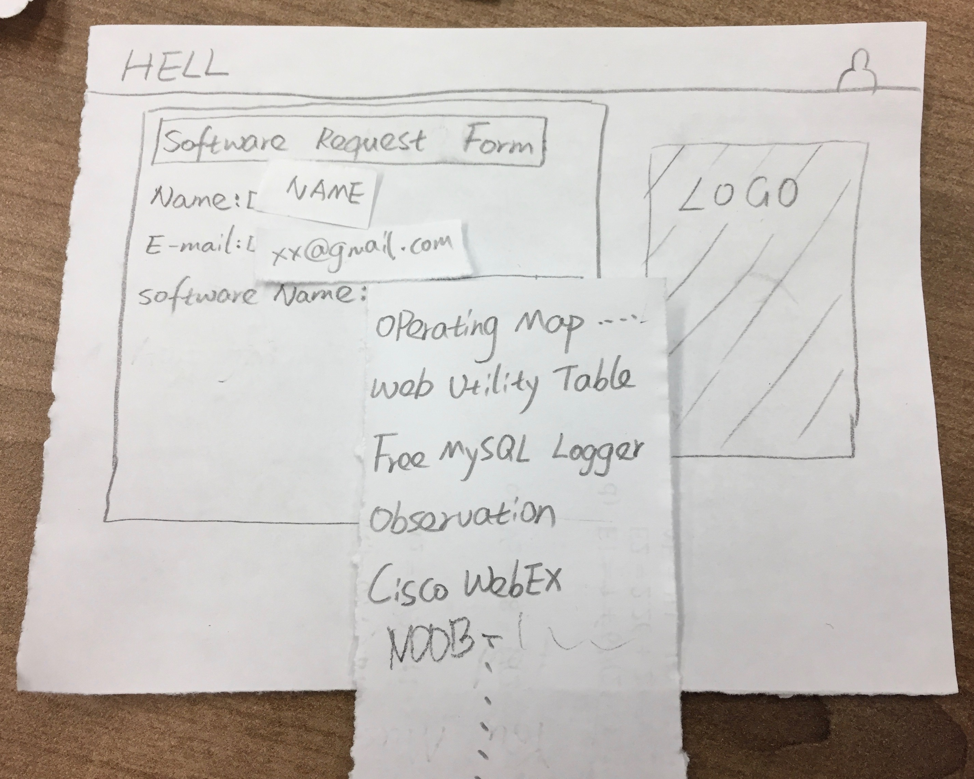
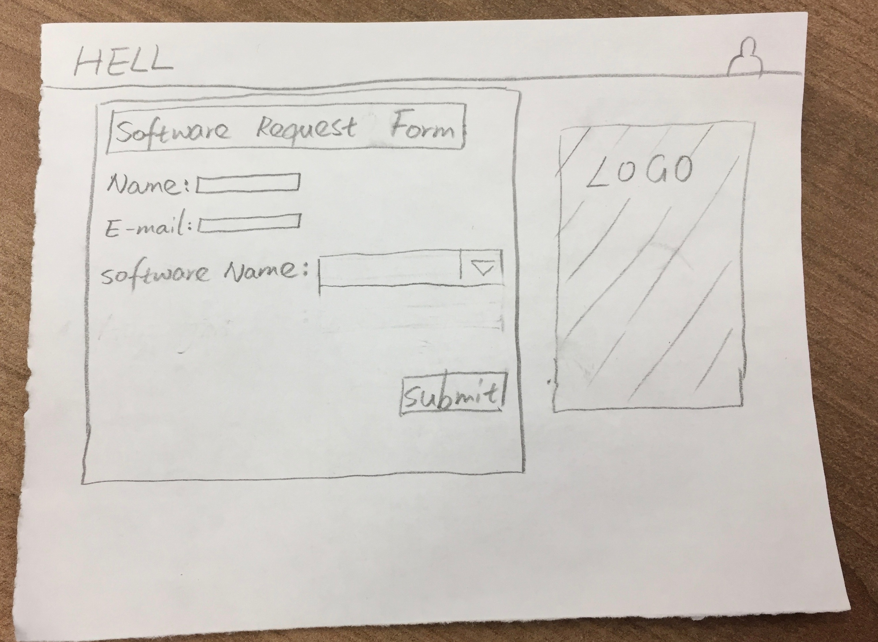
User
Notes:
Vincent

Slide 10
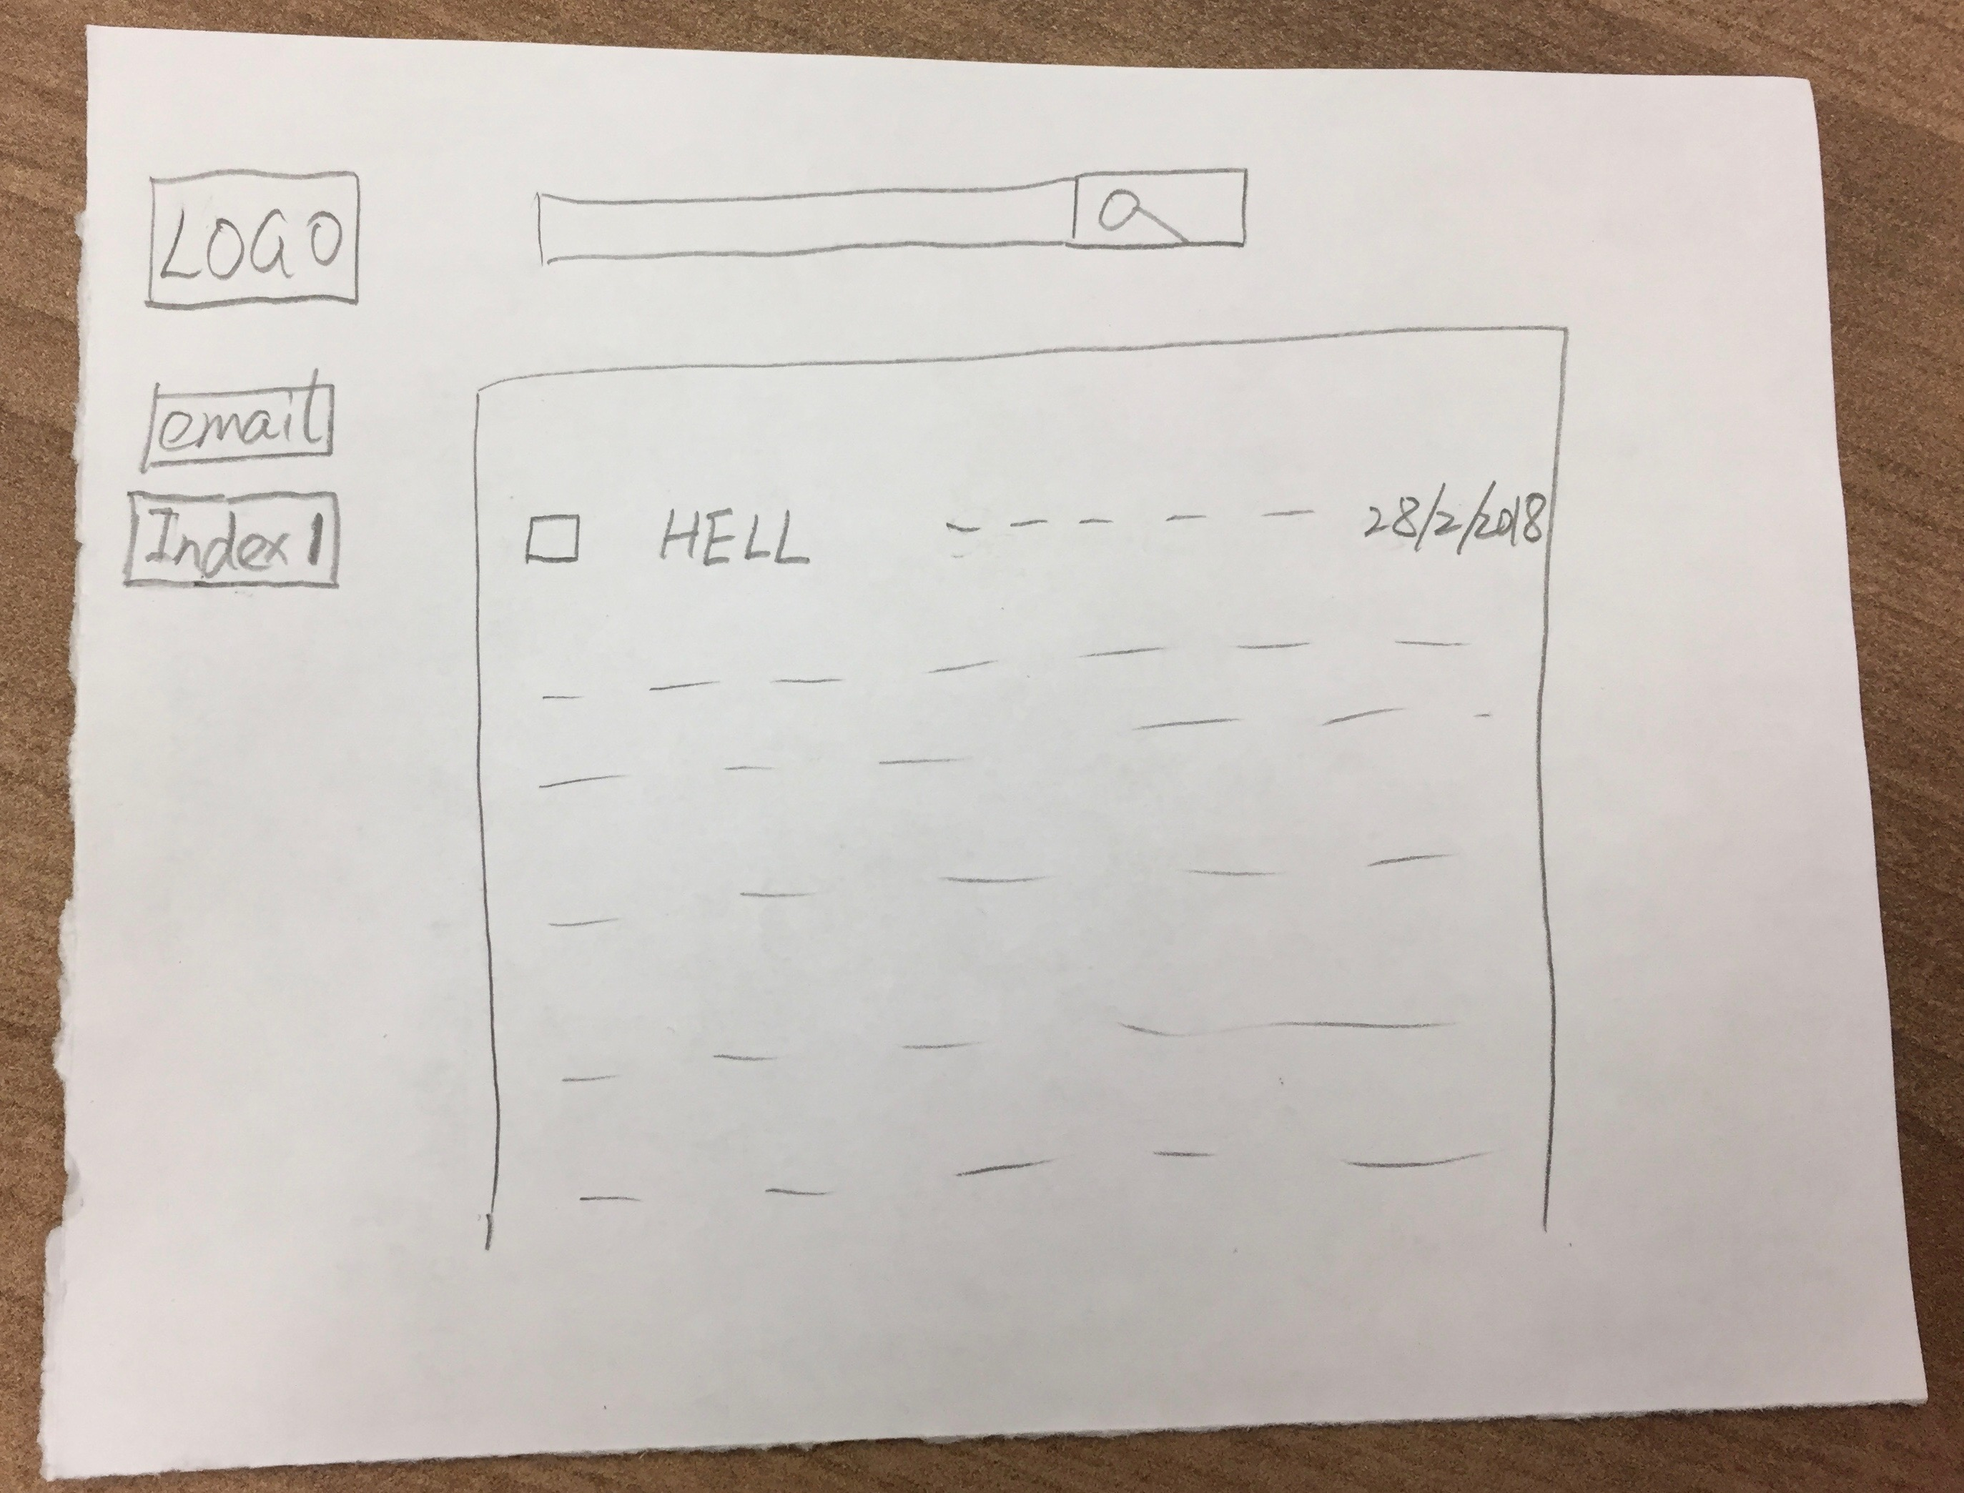
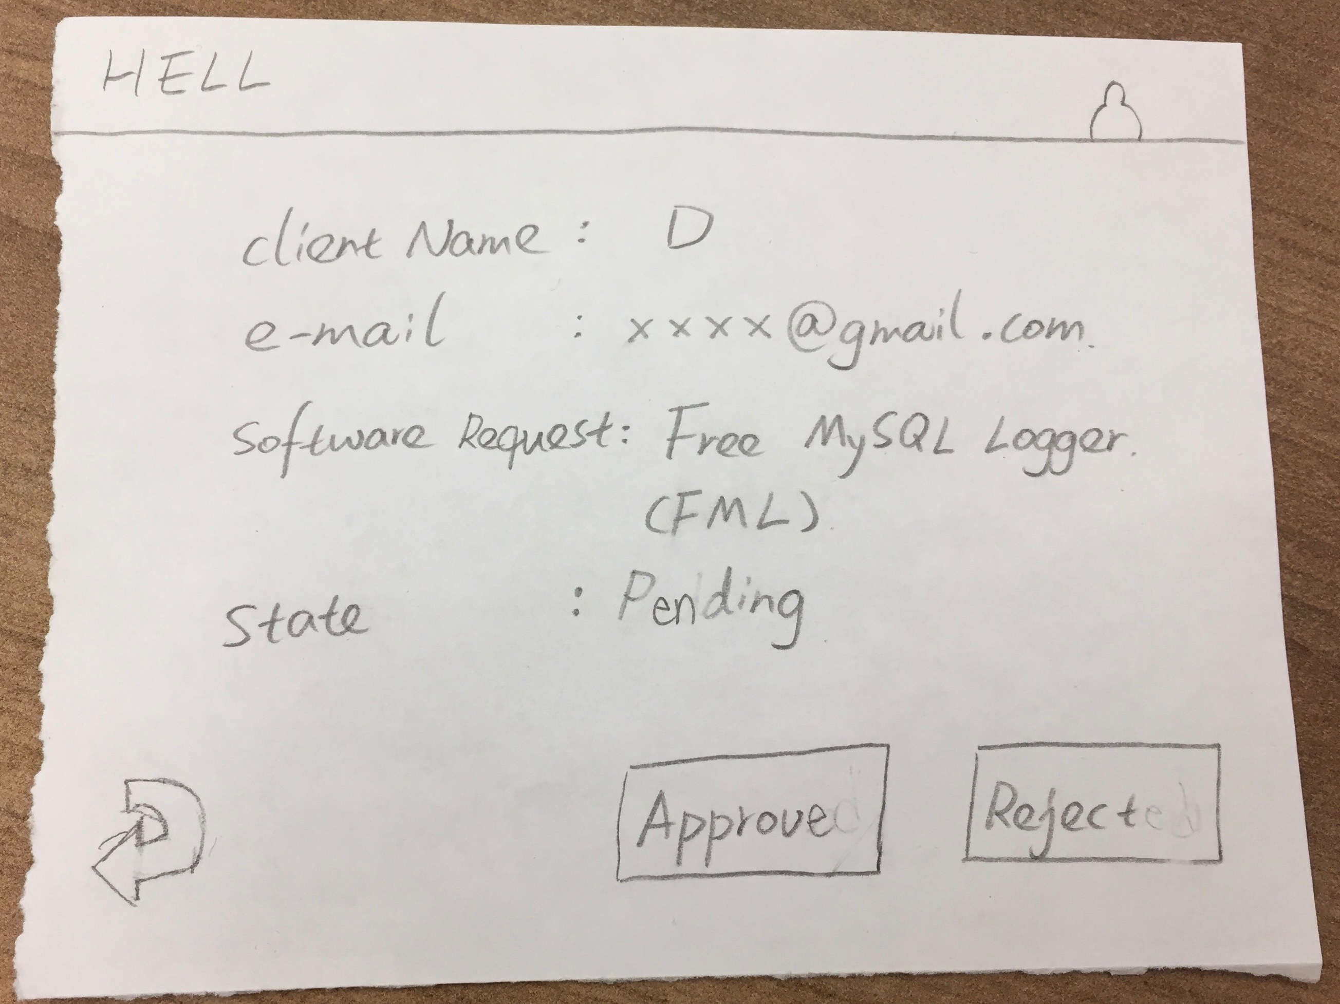
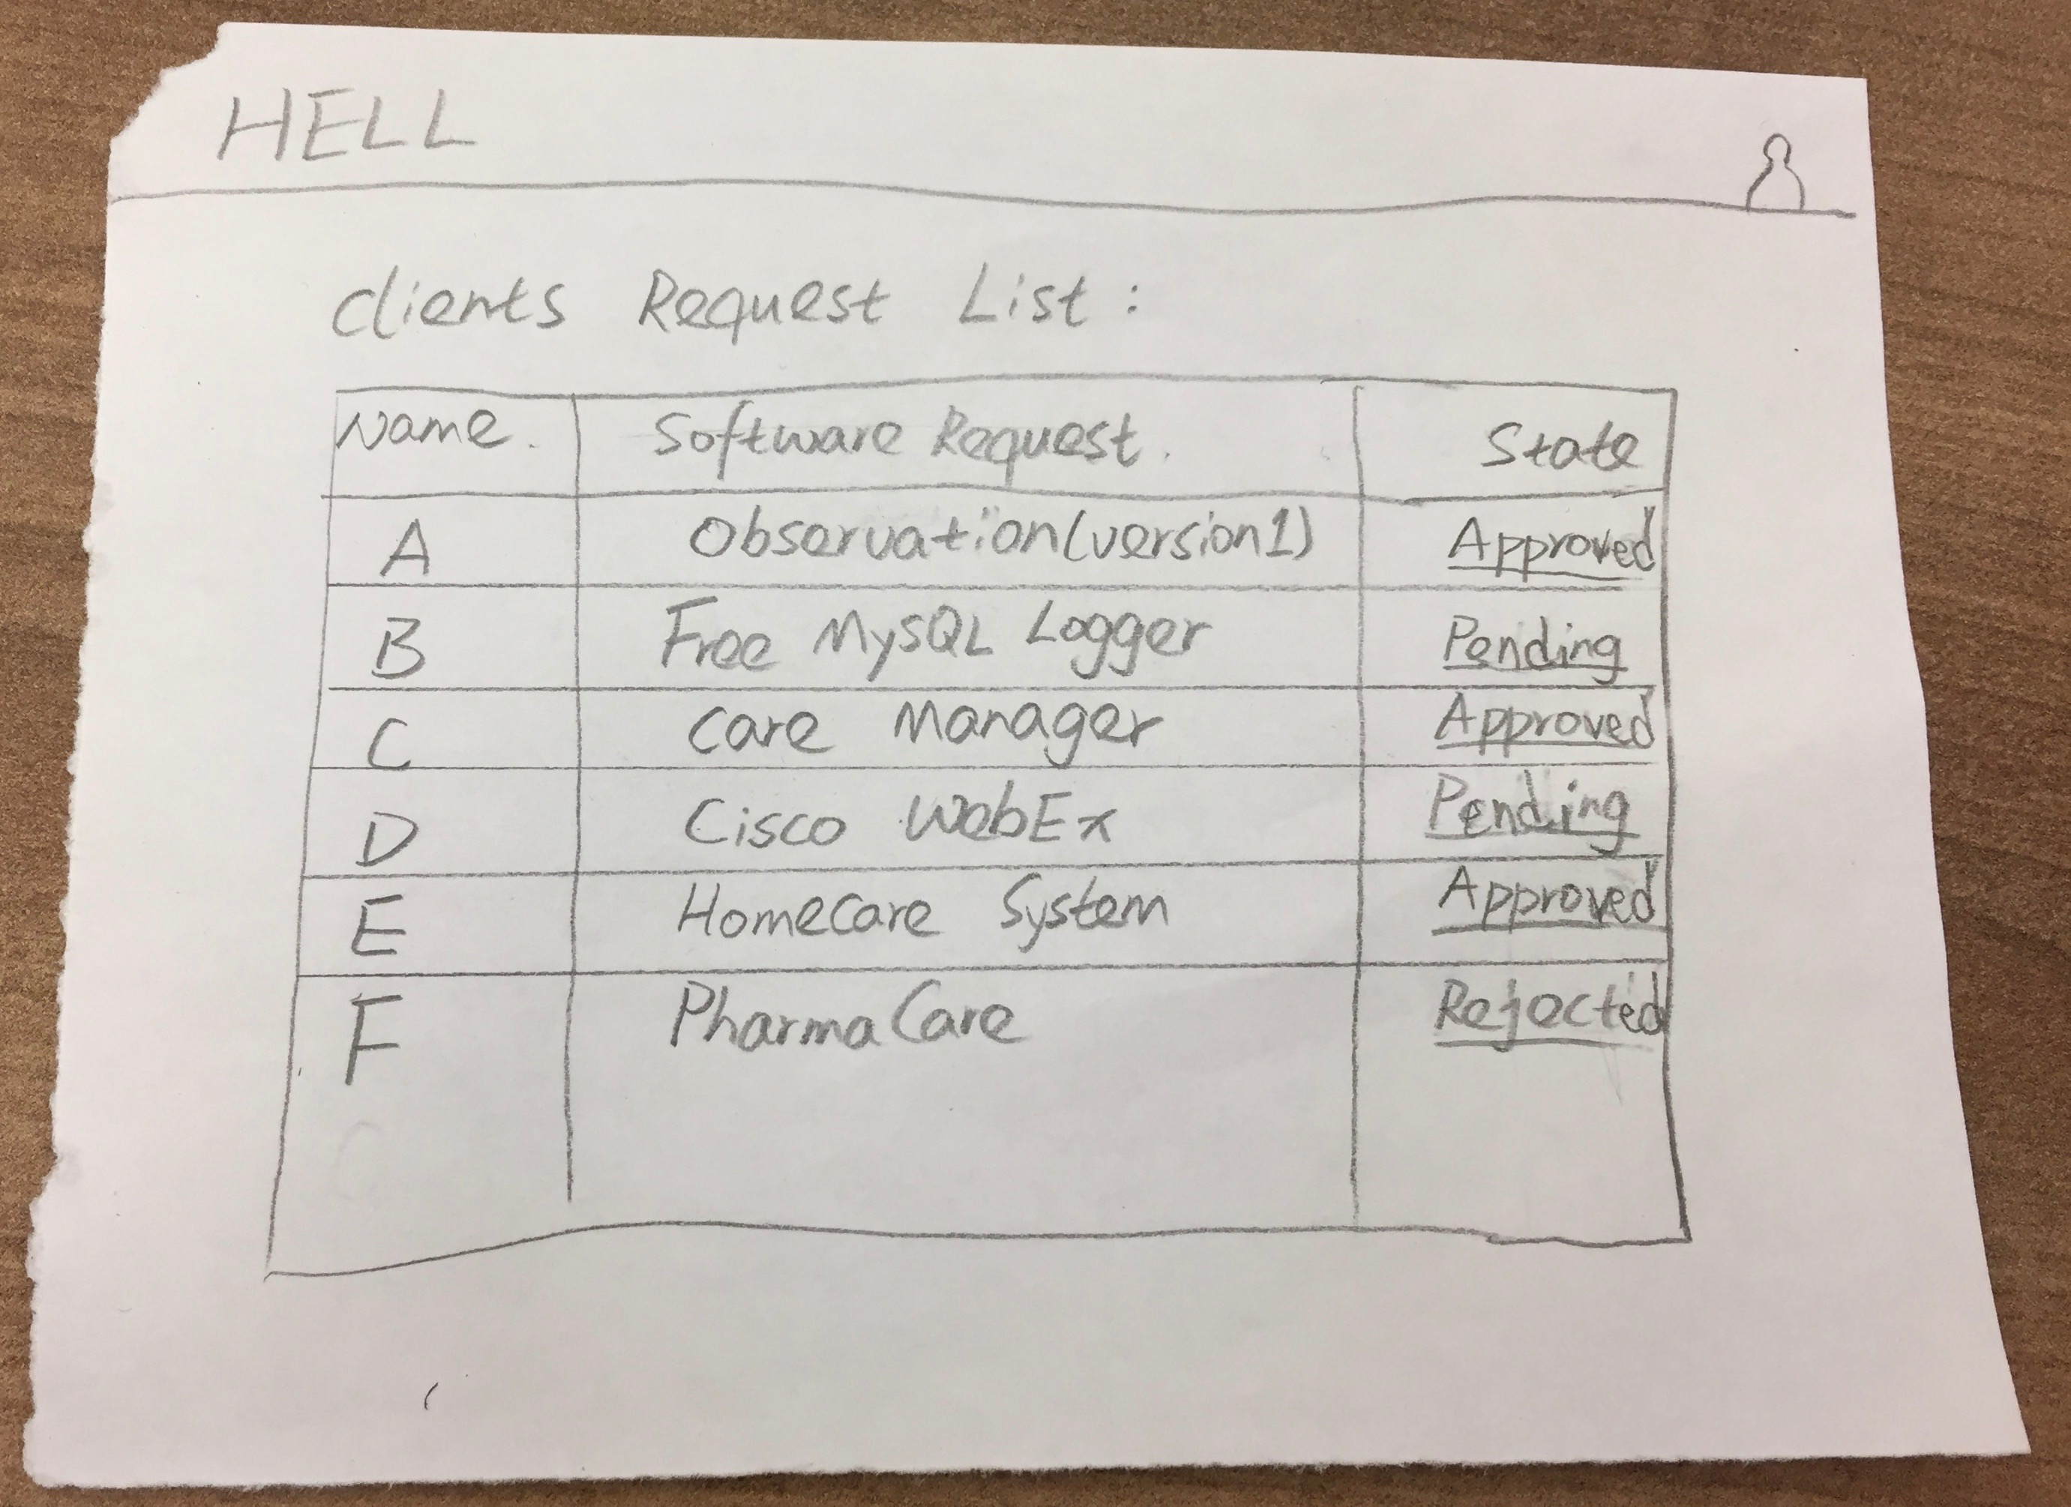
Approver
Notes:
Joe

Slide 11
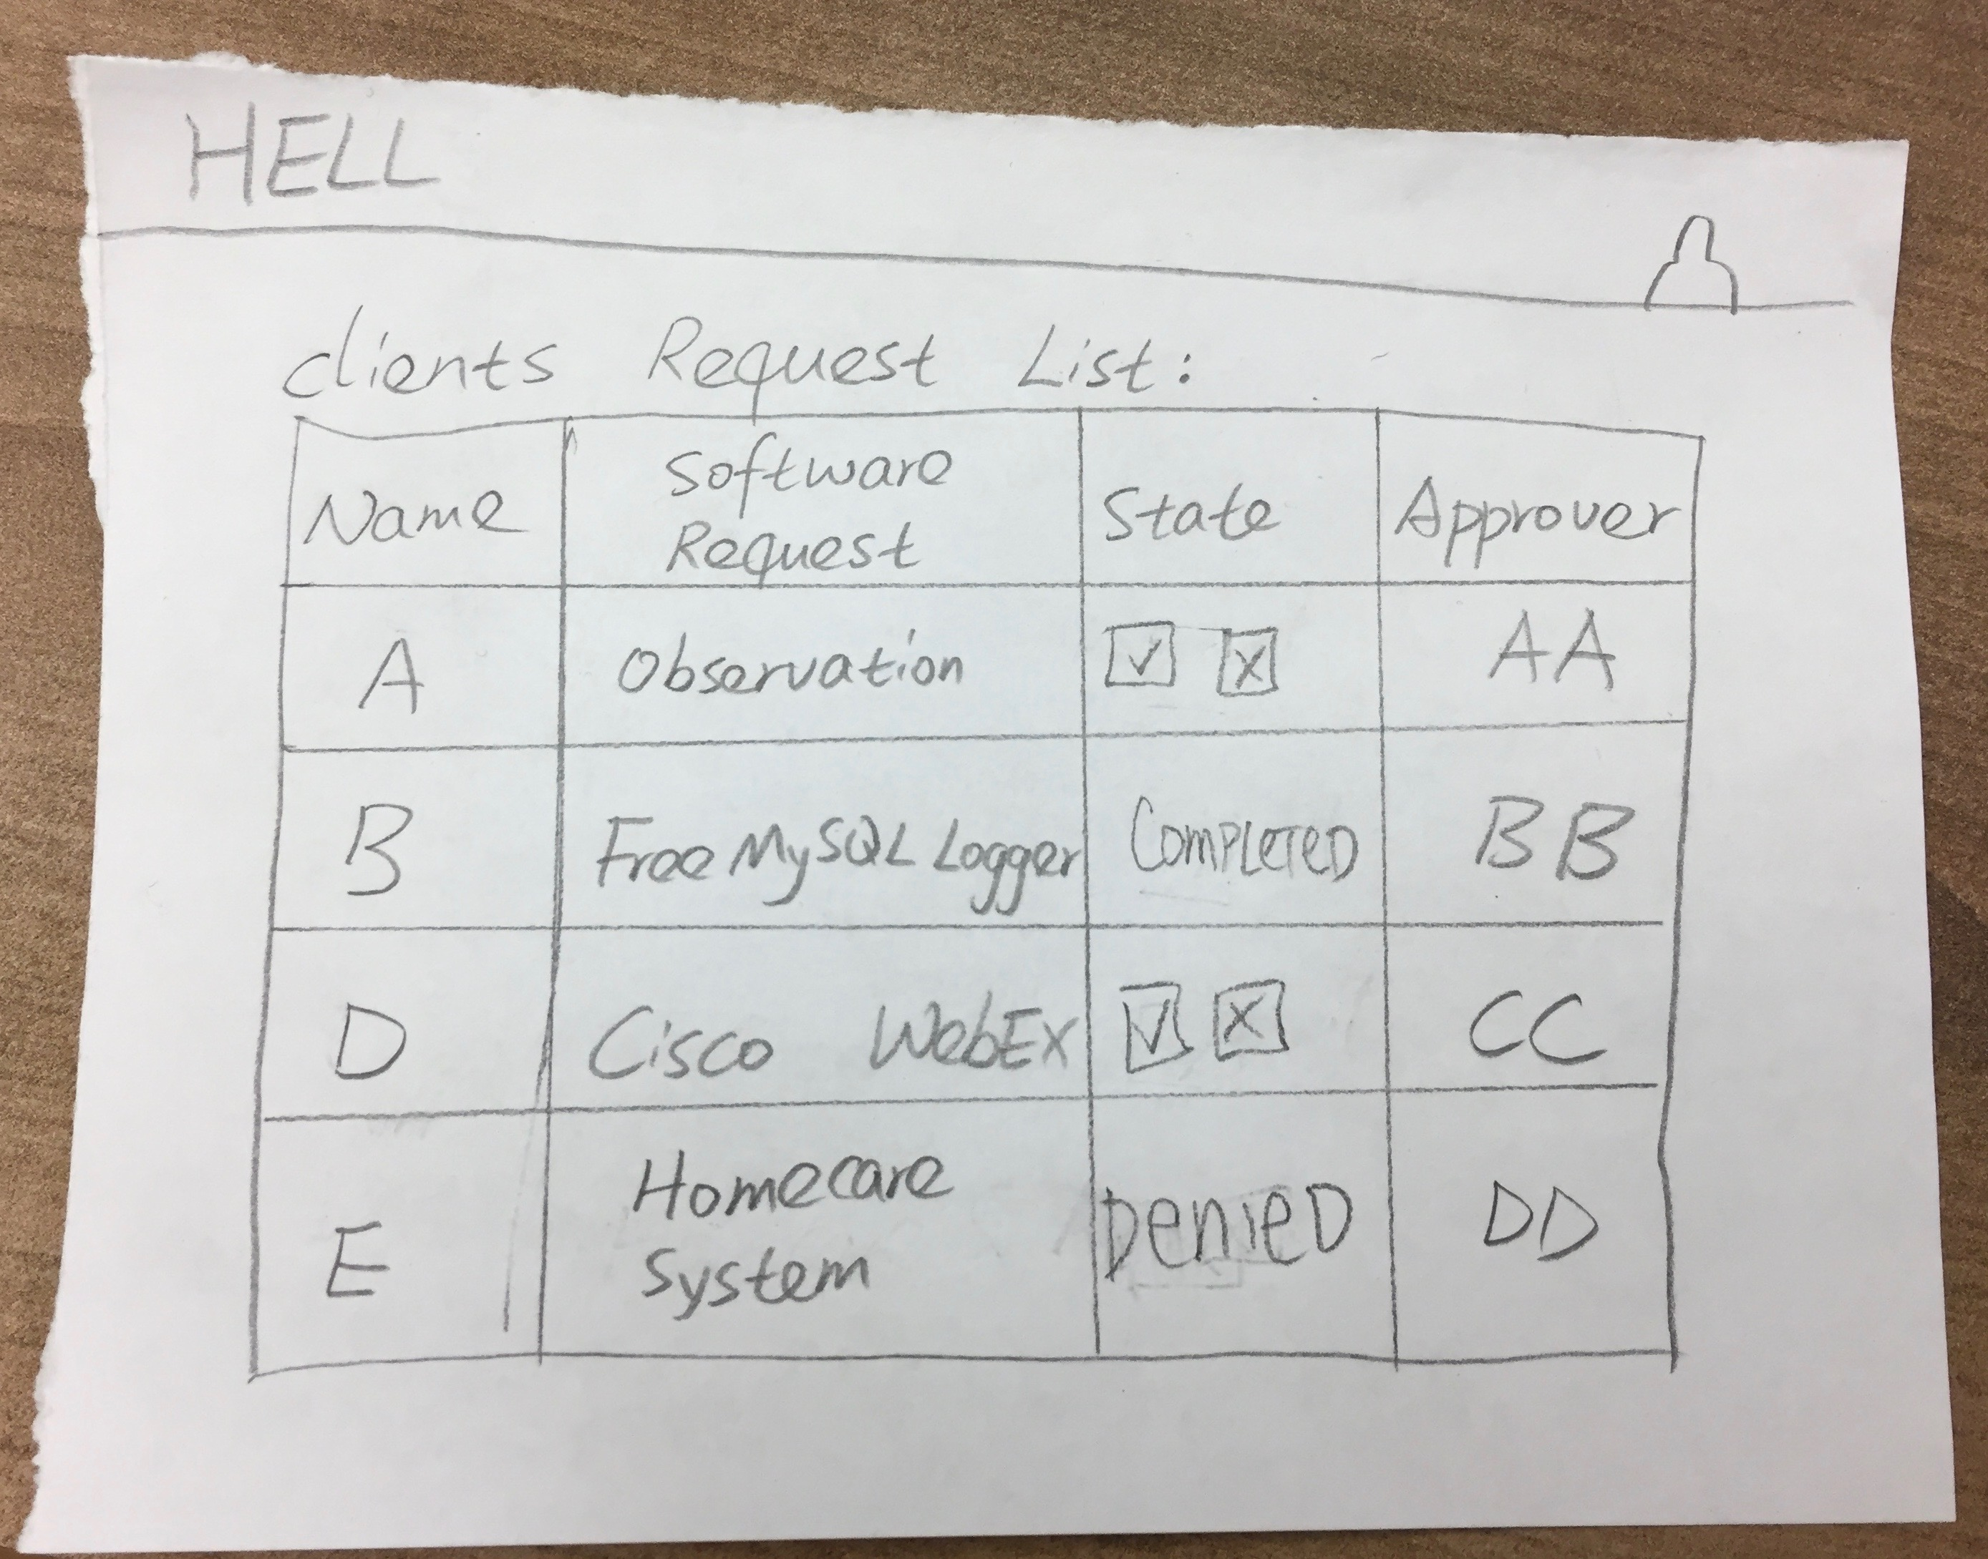
Analyst
Notes:
Joe

Slide 12
Group Reflection
How did you feel about this milestone? What did you like about it? What did you dislike?
It was a lot more detailed work compared to previous milestones.
Our project became a lot more clearer when we did low-fidelity prototyping.
What did you learn about yourself as you collaborated and worked through this milestone?
We learned low-fidelity prototype skills.
How will you use what you have learned going forward?
Helps to design a highly flexible design
What “stuff & things” related to this milestone would you want help with?
Having an easier way to make the lo-fi prototypes
Notes:
Joe

